Slide 1


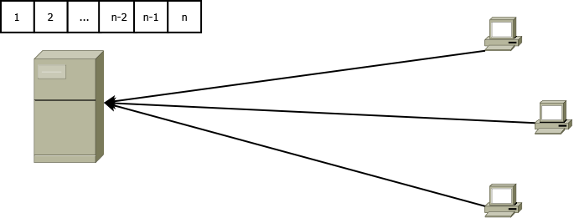
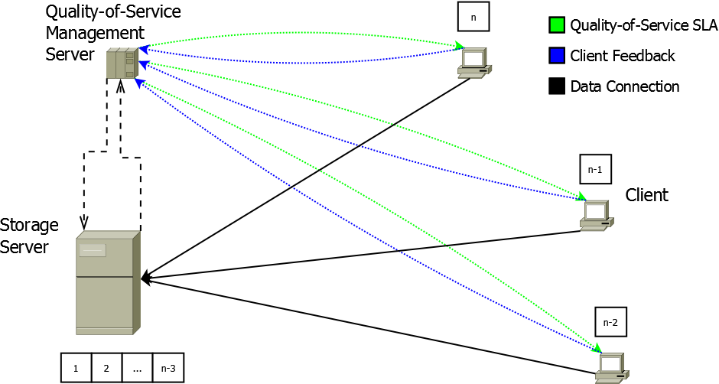
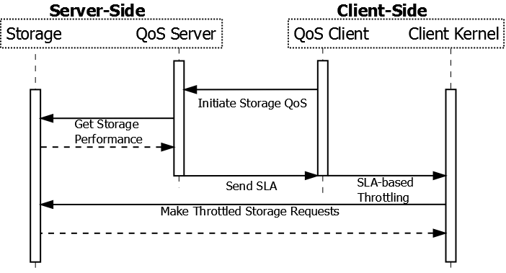
End-to-End Storage Quality-of-Service
Senior Design – Spring 2016
Team 28
Remington Campbell, Patrick Powell, Zwick Shaw
Problem
Remote storage operations in a client-server relationship are server-dependent and may result in failures during high throughput scenarios due to depleted server resources in the storage pipeline.
Solution
Distribute load across the storage resource processing pipeline by involving clients in the Quality-of-Service process.
Out-of-band management server and protocol.
Dynamically deliver storage SLAs.
Monitor storage network requirements and performance.
This allows clients to queue resource requests, optimizing the server load in the storage resource processing pipeline.

